Slide 1
CONTENTS
About This Project
Modules
Packages
Working Of Project

Slide 2
About This Project
This project is based on CARD WAR GAME.
This is a USER v/s CPU game.
First you have to enter a name and press the play button.
Read the following instructions,game will only start if you accept the terms.
Please make sure to enter the bet amount and further proceed to play.

Slide 3
If CPU wins,user will loose all bet amount.
If USER wins,amount won will be doubled.
The rare condition in which same cards could appear,WAR will occur.
In war , 5 cards each will be withdrawn from set of both players.
Random 1 card will be withdrawn each from both player.
In case of war , if user wins then he wins all the lost bet amount till now.
And if the CPU wins then USER loses all the winning amount till now.

Slide 4
MODULES & LIBRARIES
Tkinter
It provides a powerful object-oriented interface to the Tk GUI toolkit.
PIL(pillow)
It is a Python Imaging Library (PIL), which adds support for opening, manipulating, and saving images.
pygame
It includes computer graphics and sound libraries designed to be used with the Python programming language.
random
The random module gives access to various useful functions and one of them being able to generate random floating numbers, which is random().

Slide 5
PACKAGES
ImageTk
Image
messagebox
Font
Mixer

Slide 6

Working Of Project

Slide 7

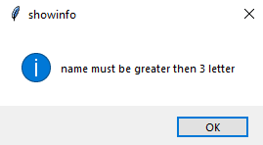
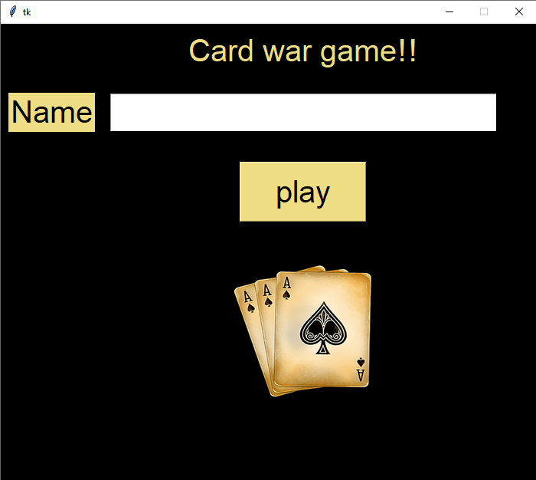
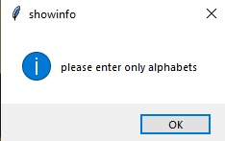
Front Page
If you dosen’t enter anything:
If you enter a numerical value:

Slide 8
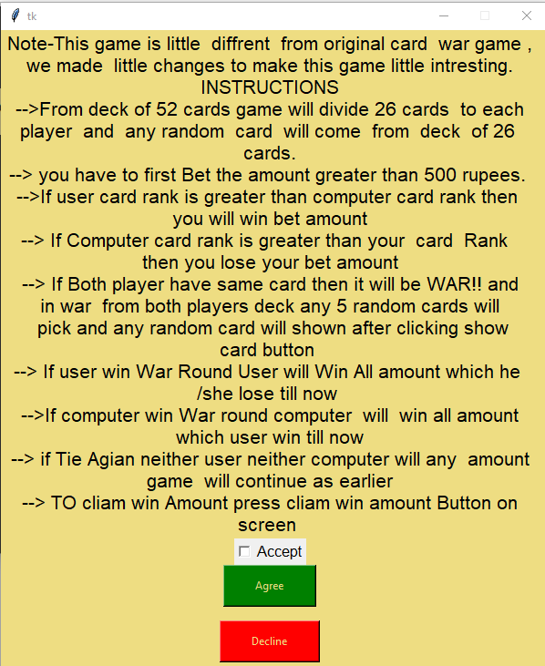
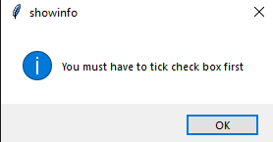
Instructions Page
If you does not tick checkbox:

Slide 9
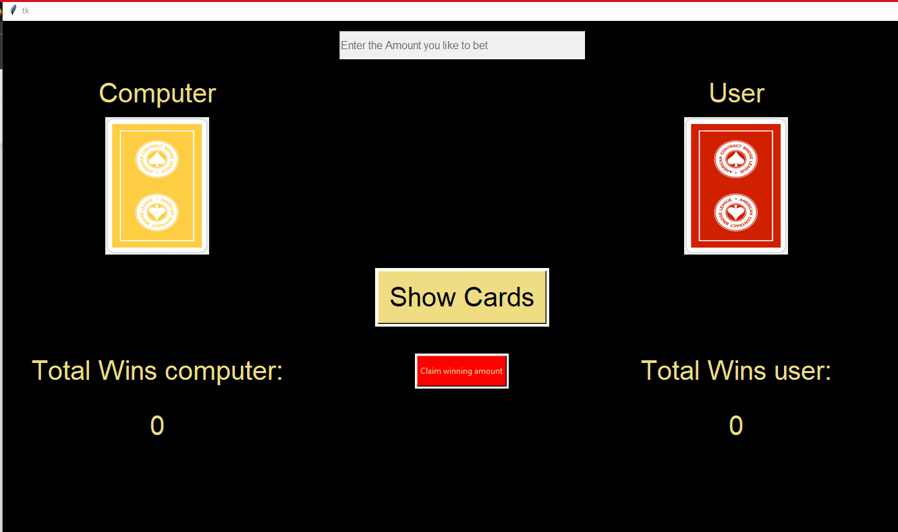
Main Game Panel

Slide 10
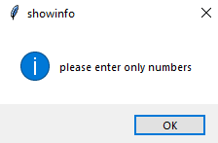
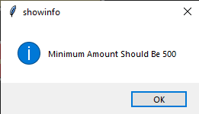
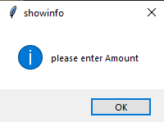
If you enter any alphabet
If you enter less than 500
If you don’t enter any amount

Slide 11
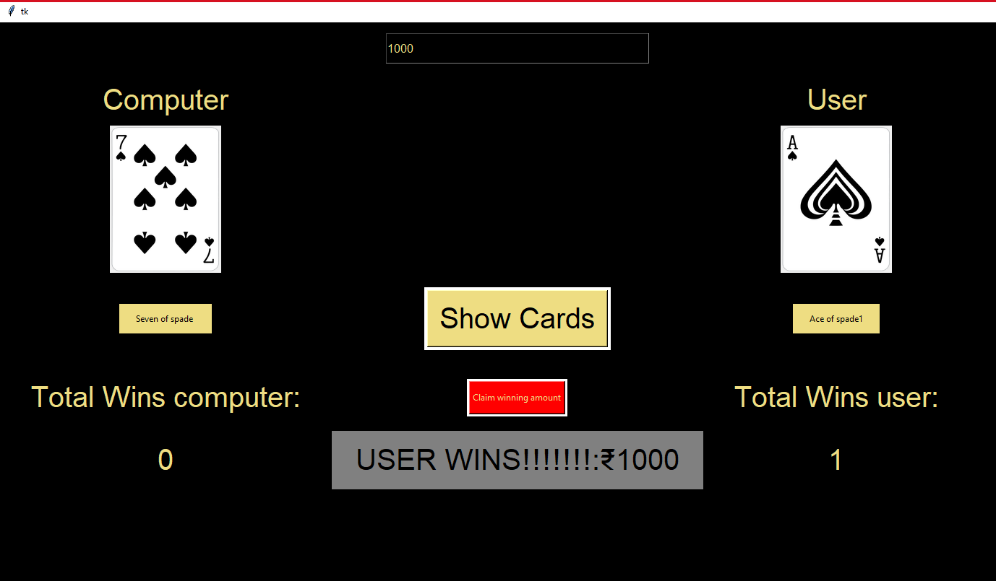
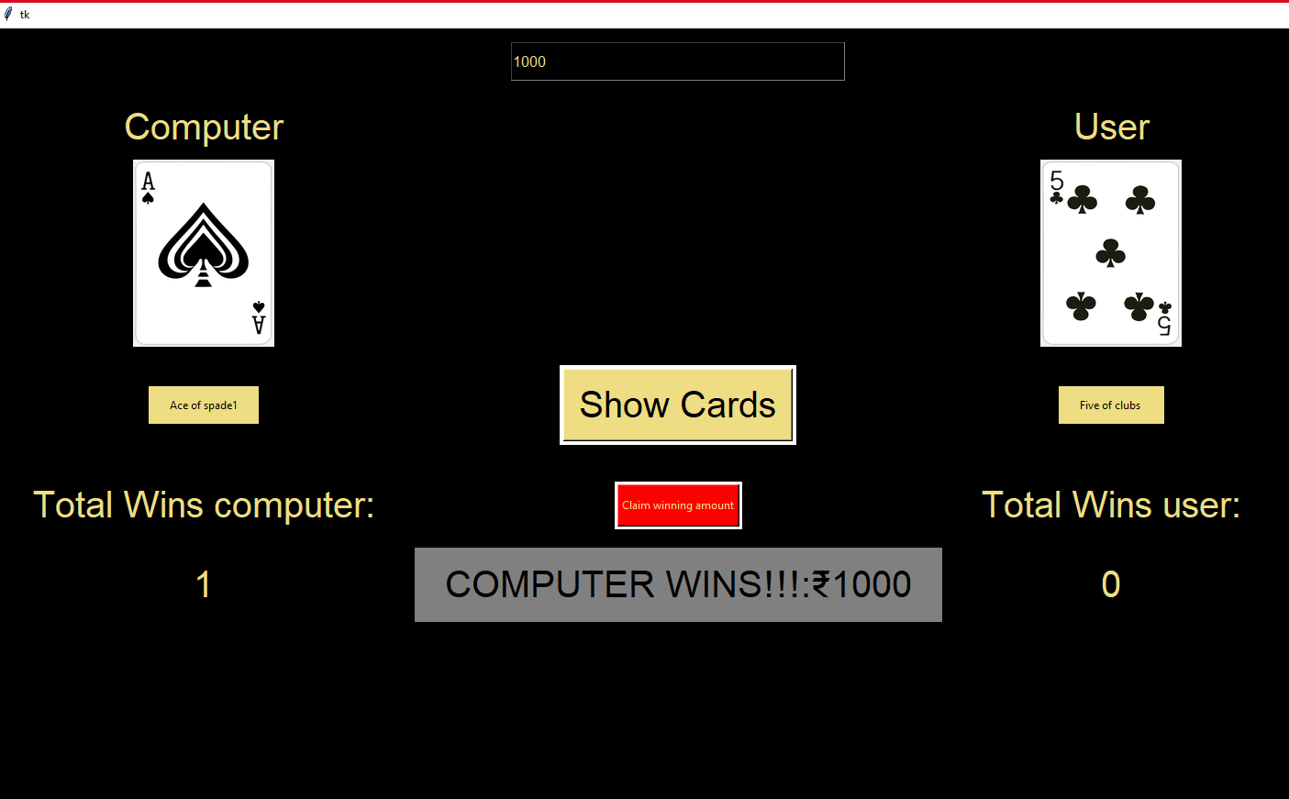
If user wins
If computer wins

Slide 12
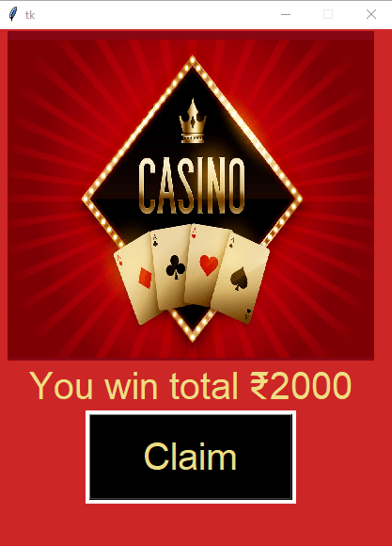
Claim Window!
After winning, user can claim the winning amount and after claiming, the game window will close.

Slide 13
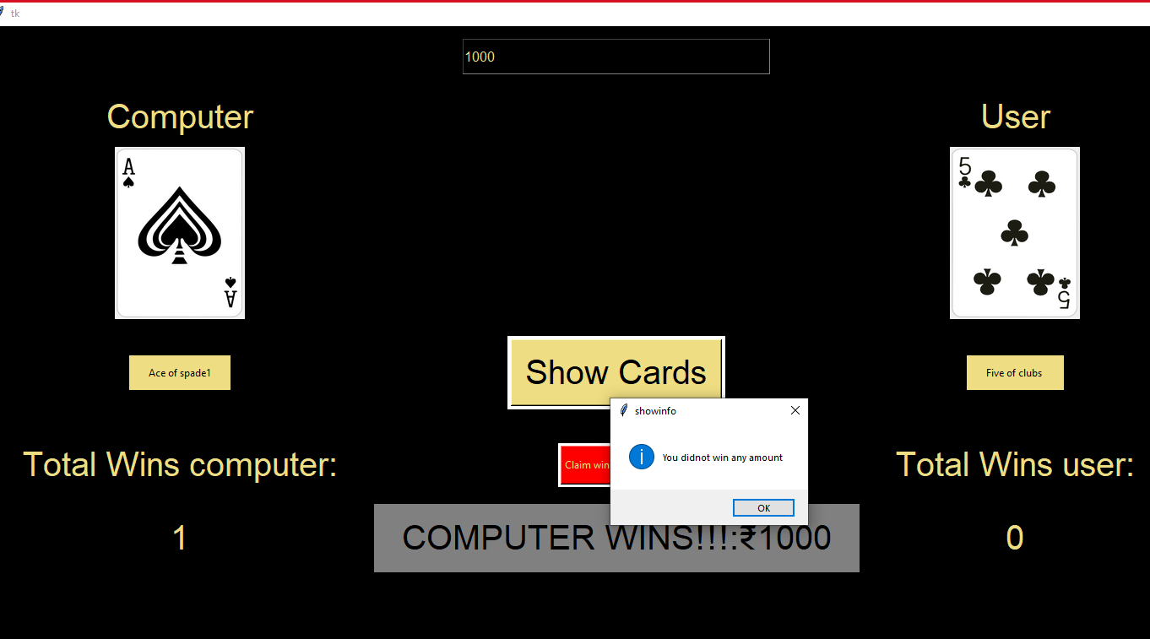
If user claims the amount without winning!

Slide 14

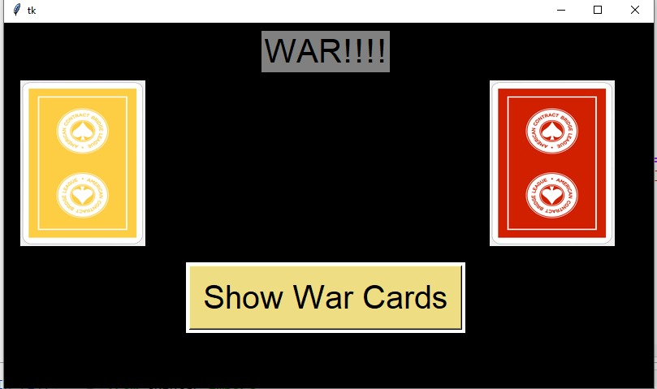
CARD WARS

Slide 15
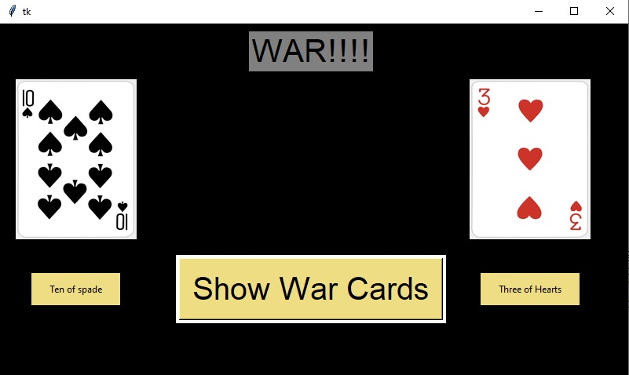
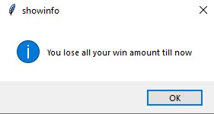
Computer wins the card war

Slide 16
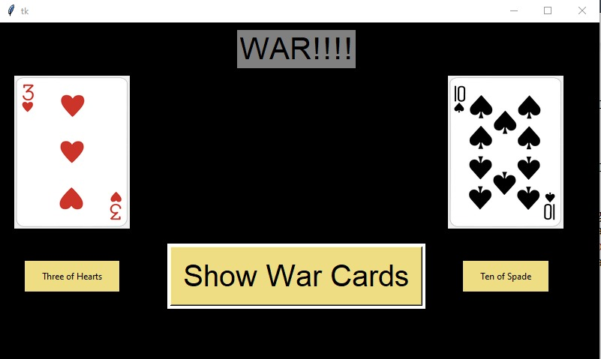
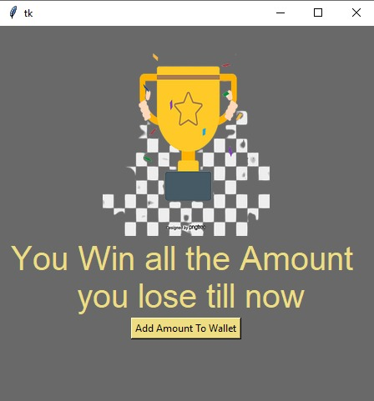
If user wins the war round , then he will receive all the lost amount till now

Slide 17
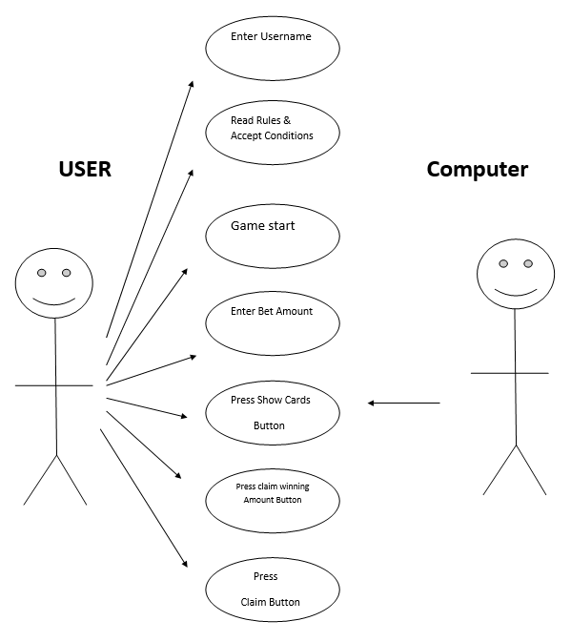
USE CASE DIAGRAM

Slide 18
DFD

Slide 19
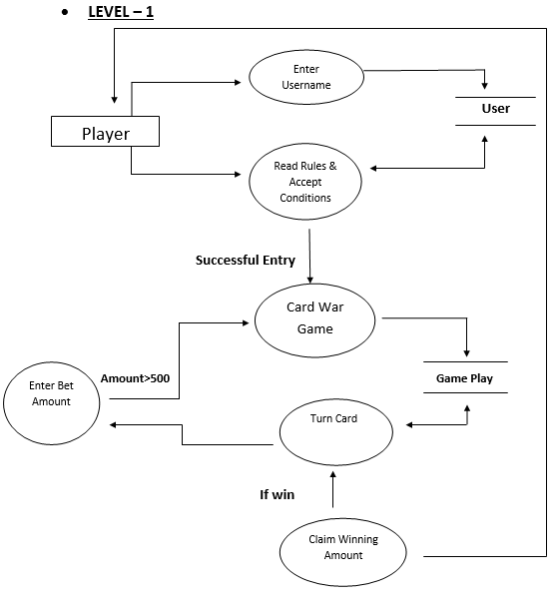
LEVEL 1

Slide 20
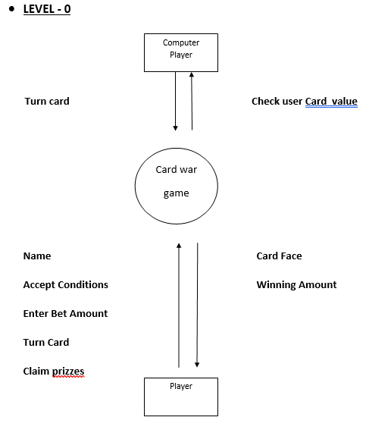
LEVEL 0

Slide 21
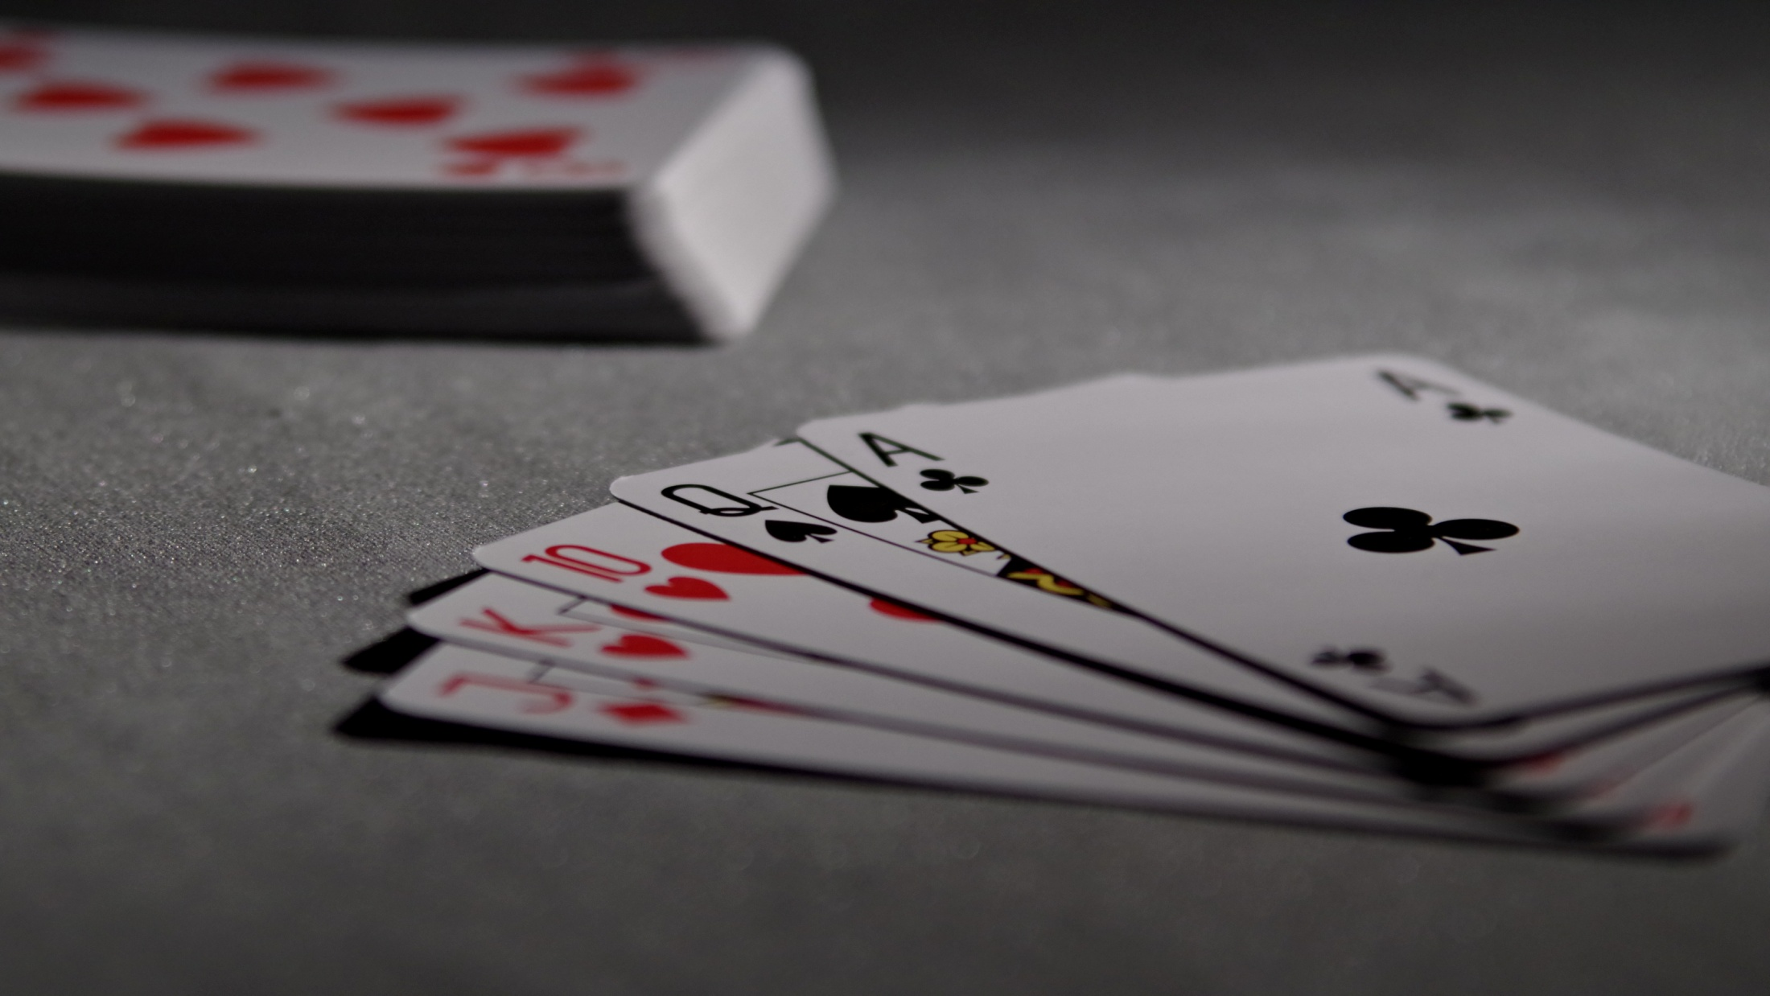
THANK YOU

